Slide 1
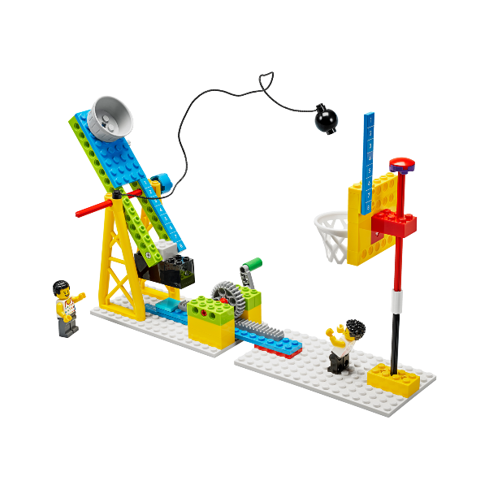
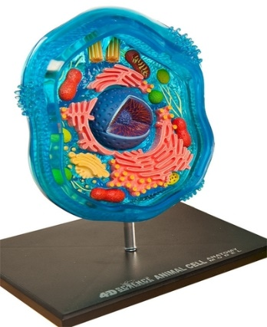
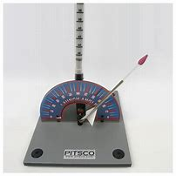
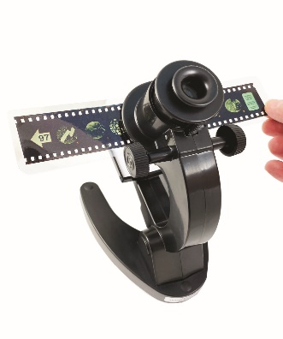
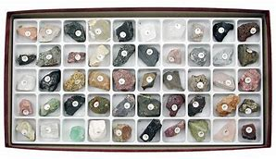
Welcome to the Southwest Indiana STEM Resource Center Virtual Presentation!
We invite you to click through the presentation to learn more about this one-of-a kind resource. The first part of the presentation gives you some background… but keep clicking to see examples of the over 1,000 pieces of STEM equipment available to you. Middle School is probably the best-served age group at the Resource Center. We have many items designed for Middle School students, and many of the items geared to Elementary and High School are easily adaptable.

Slide 2
SwISTEM Resource Center
Outreach Activities
Tri-State Science and Engineering Fair
First Lego League
Teacher Professional Development
Equipment Lending Service
Science Olympiad
Curriculum/ Instructional Assistance
Equipment Circulation
The Equipment Lending Service arm of the Resource Center has over 1,000 pieces of equipment that we lend… and we deliver and pick-up right to your school… all for FREE! If you have questions about any other arm (First Lego League, Science Fair, or Science Olympiad), just ask! We are currently looking for Middle School Science Olympiad Teams… let us know if you would like more information!

Slide 3
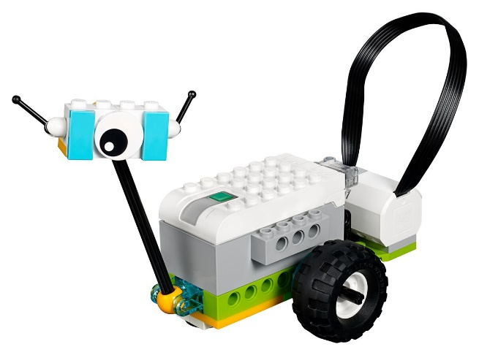
SwISTEM Equipment Lending Service
The Equipment Lending Service offers delivery to all schools in a 12-county region, including Vanderburgh, Warrick, and Posey counties. All items are loaned for 2-week periods, and most come with a curriculum or user’s guide. We are a completely FREE service funded by the University of Southern Indiana.
The STEM items we loan were all recommended by educators. And we have classroom sets of everything, so every student has a chance for hands-on STEM education. Some of our items are STEM games– fun but with an underlying STEM theme. Other items are educational tools. We know that teachers need both! We are here to help with whatever STEM needs you have. And if you don’t see what you need, just ask. We frequently partner with USI Biology, Physics, Geology, and Chemistry departments to provide materials to schools.

Slide 4
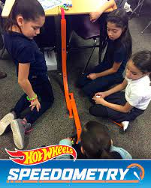
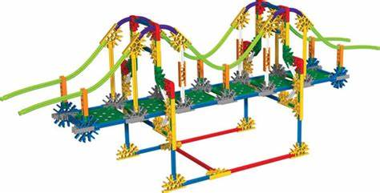
SwISTEM Equipment Lending Service
We have many materials designed for Middle School students, and other items that are easily adapted for use in Middle School.
The following slides highlight some of our most popular items for Middle School.
To go directly to our searchable equipment database OR to print a paper copy of our inventory, click here:
SwISTEM Equipment Database
Paper List of Available Equipment

Slide 5
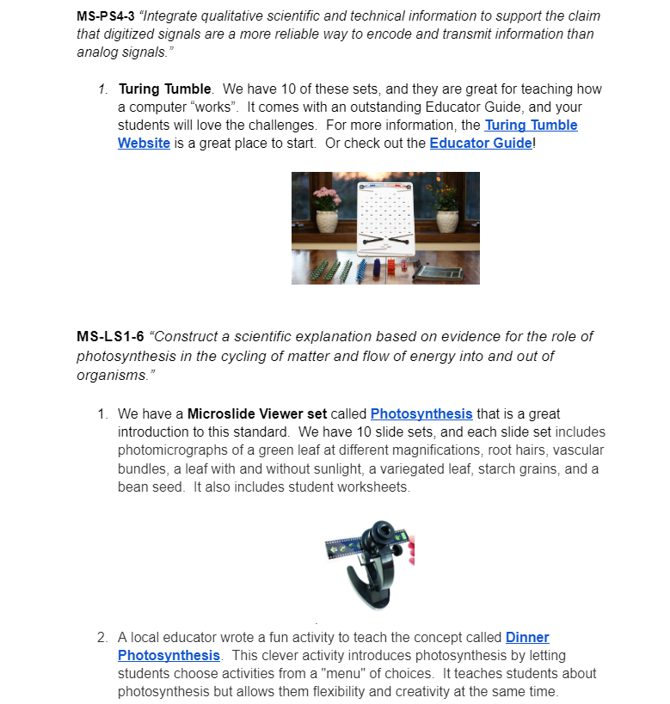
SwISTEM Equipment Lending Service
We now have activities and materials linked directly to Middle School Standards. This is a great way to find items from our inventory (and an activity or curriculum) that address your standard of interest!
All activities linked to standards are FREE and do not require log-in, passwords, or money!
6th Grade Standards
7th Grade Standards
8th Grade Standards

Slide 6
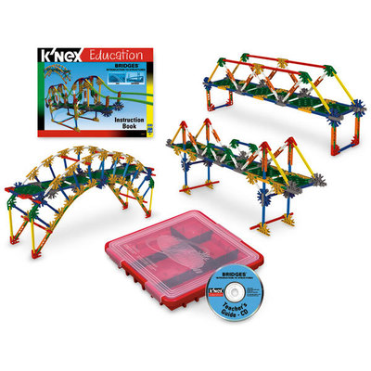
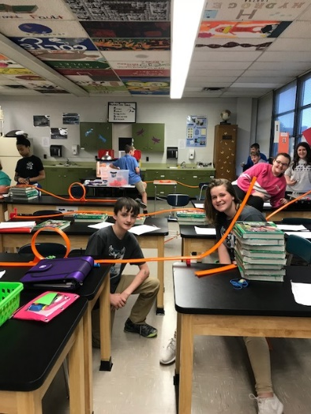
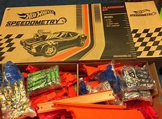
SwISTEM Equipment Lending Service
K-Nex Introduction to Bridges
This kit contains 207 pieces, including rods, stems, and connectors. Build 13 fully-functioning replicas of real-life bridges. These models help educate builders about bridge infrastructure by demonstrating key bridge types, such as truss, arch, cantilever, beam, suspension, movable/bascule, and cable-stayed. Building instructions and a teacher’s guide are included. Set also includes worksheets. Perfect for Middle School. We now have 10 of these sets!
Hot Wheels Speedometry Set
Our most popular Middle School Item! Teaches about forces, motion, speed, and velocity with an easy- to -use curriculum. Our set has enough cars, tracks, and loops for a whole classroom. The curriculum was designed for 4th grade, but it works great with older grades. They just dig deeper! You can also use it with our Photogate timers for actual data analysis.
Speedometry Curriculum

Slide 7
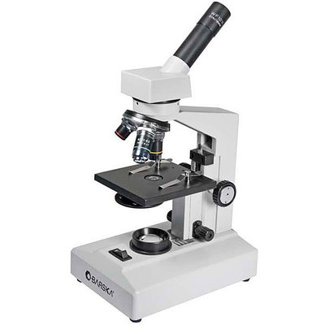
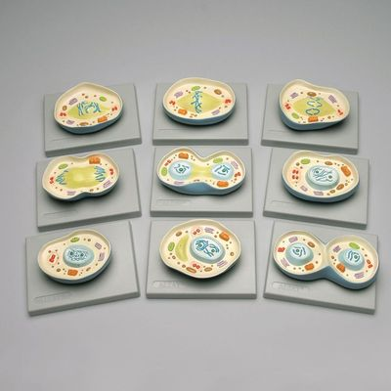
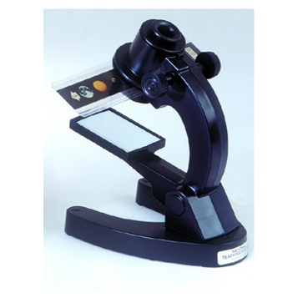
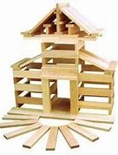
SwISTEM Equipment Lending Service
Cell Biology Resources
We have many choices to aid with teaching cell biology. Most teachers borrow more than one at a time, so feel to request multiple items (click on the resource to see a picture and description)!
Microscopes: We have over 20 high quality microscopes. We even have a few battery-operated microscopes if you don’t have enough electrical outlets in your room. We can also provide prepared slide sets. We have several choices, including Beginner’s Biology and Plants and Animals
3D Cell Models: We have 30 of each of both Plant and Animal cell models. These are great because students can take them apart and “feel” a cell. They also come with a helpful booklet.
Giant Animal Cell: We have a giant animal cell model for classroom demonstration purposes.
Microslide Viewers: Perfect for Middle School, Microslide Viewers provide a microscope experience without the hassle. The viewers work with slide sets, including Animal Mitosis, Cells of Plants and Animals, Meiosis, and Plant Mitosis. Each set comes with student worksheets and slide descriptions. We have 10 of each slide set.
Cell Mitosis Model Set: This demonstration set has a model for each stage of Mitosis. Each stage is labelled on the back, so it is perfect for quizzes or review.
Cell Meiosis Model Set: Like the Mitosis set, this model includes each stage of meiosis.
Magnetic Animal Cell: Giant Model of the cell (including removeable parts) that adheres to any magnetic Surface. We have 2 of these.

Slide 8
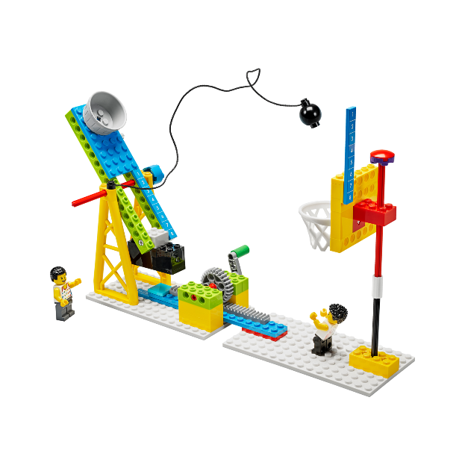
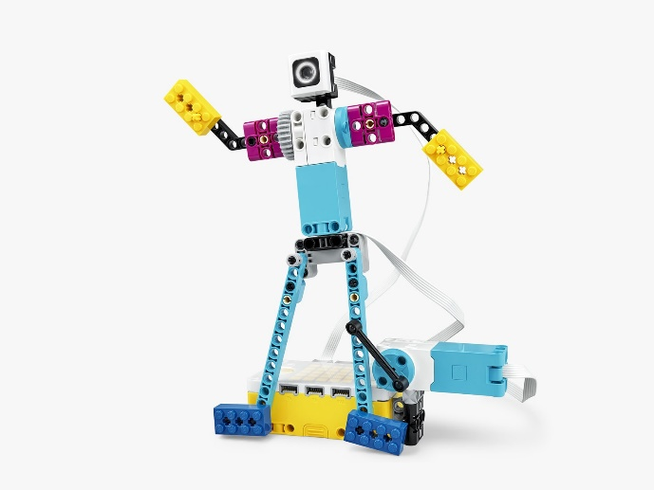
SwISTEM Equipment Lending Service
Lego BricQ Motion Prime
The LEGO® Education BricQ Motion Prime Set engages students in grades 6-8 in the exploration of physical science within a sports context. BricQ Motion helps foster an understanding of forces, motion, and interactions by providing easy hands-on learning experiences without the need for technology. Students first build a Lego model and then work on solutions to a problem!
BricQ Motion Prime Overview Video (brief)
Lesson Plans for BricQ Motion prime
Lego Spike Prime
Lego Spike Prime is Lego’s robot for Middle School (it replaces the EV3). Using software that is easily downloaded to any tablet or computer, students learn how to block program. These kits require hours of time, so they are perfect for an afterschool club OR a class geared to robotics.
Lego Spike Prime Video (brief)
Lego Spike Prime Lessons

Slide 9
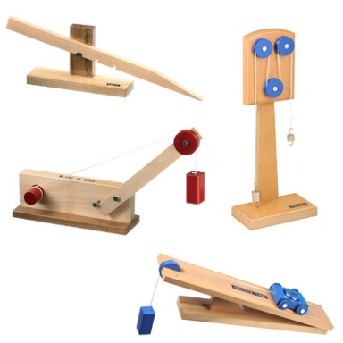
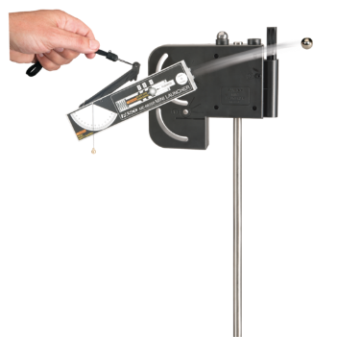
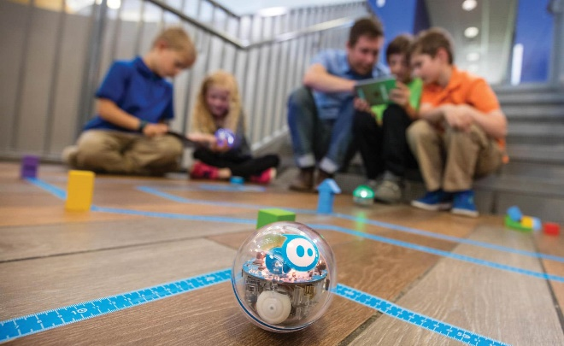
SwISTEM Equipment Lending Service
Simple Machines
We love our wooden Simple Machine Sets. Instead of just reading about why simple machines make life easier, your students can do actual experiments for a lesson that really sinks in. Each model is approximately 7" x 16“ and each has an excellent experiment guide (click on the machine type to see the guide). Set includes inclined plane, wheel and axel, lever, and pulley. You can request up to 4 sets so students can learn in groups. Also available: spring scales and mass sets– these can be helpful for students to see the actual differences in force required.
Mini-Launcher
The Mini Launcher allows students to thoroughly investigate projectile motion. With three, highly repeatable launch speeds, precise launch angle measurements, and the ability to shoot downward, the Mini Launcher enables students to explore projectiles through dynamic, hands-on inquiry. Check out the teacher manual to see how you could use this launcher in your classroom!
Spheros
We love our 3 classroom sets of Spheros! They are programmable robots– but there is no building, so you can get to the programming very quickly. An effective coding lesson could even be done in 45 minutes. Our set comes with a mat and activity cards, and there are several levels of programming available. Perfect for students at different levels. Check out the outstanding Teacher Guide or see more information on the Sphero Web Page.

Slide 10
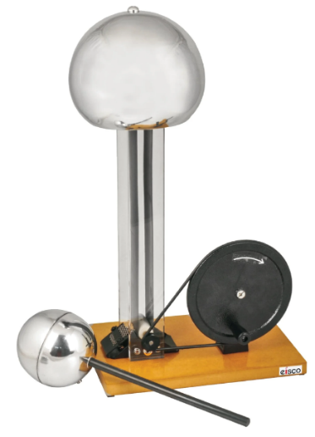
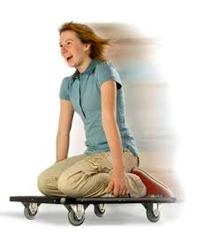
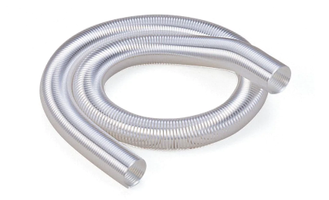
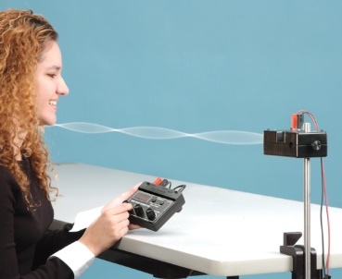
SwISTEM Equipment Lending Service
Hand-Cranked Van de Graaff Generator
Also known as an electrostatic generator, this item allows you to perform basic electrostatic demonstrations. It comes with an electrostatics kit that contains items like fur and tin plates to enhance your demonstration! Raise your hair and demonstrate the fun of science!
Video on Electrostatic Generators
Human Dynamics Cart
These carts are an easy and fun way to demonstrate Newton’s Third and/ or First Law– or any force/ motion concept. If you use two carts, each student can sit on a cart facing each other and gently push. The students will move in opposite directions. We have 7 of these carts, but two may be enough for demonstration purposes. For more information, watch this short Human Dynamics Cart Video or look at the Teacher Guide.
Wave Materials
We recently purchase materials to help address wave standards. We have 4 great options to aid in teaching what can be a difficult topic:
Spring Waves: A plastic slinky, so less tangling– and we have 14 of them! Perfect when used with Wave Activities Worksheet
Giant Metal Spring: Giant slinkys! We have 14 available.
Mini Ripple Tank: Great for classroom demonstration. Ripple Tank Info
Mechanical Wave: Another great classroom demo item using sand.
String Vibrator/ Sine Wave Generator: We have a great classroom demo using these cool tools: Standing Waves Lab

Slide 11
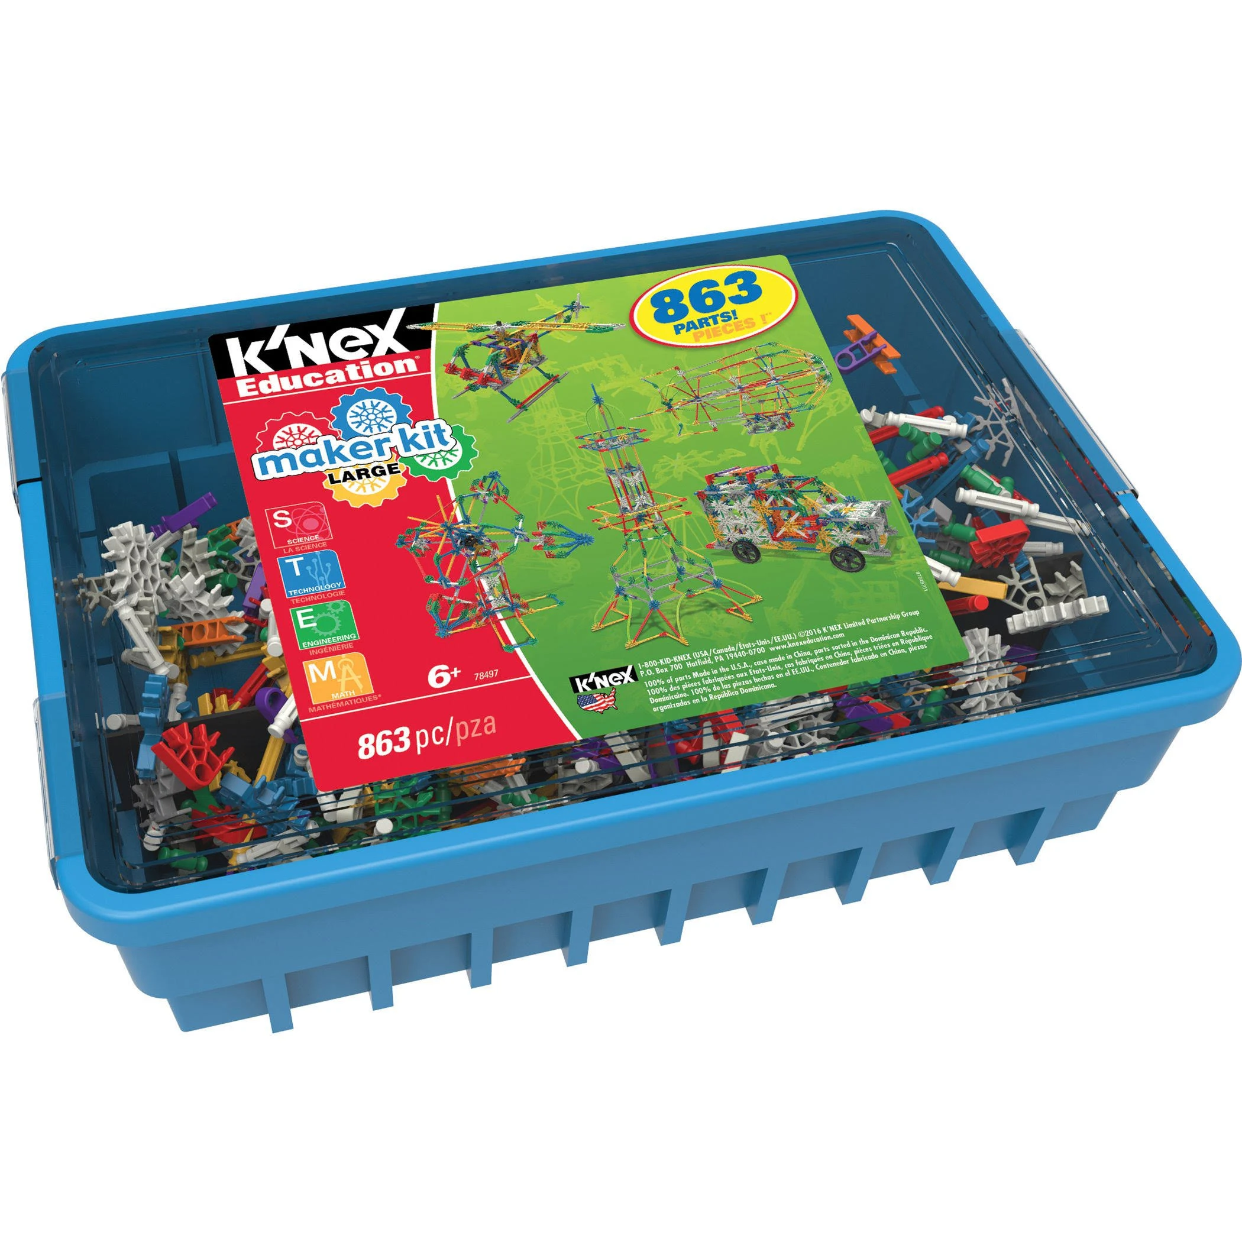
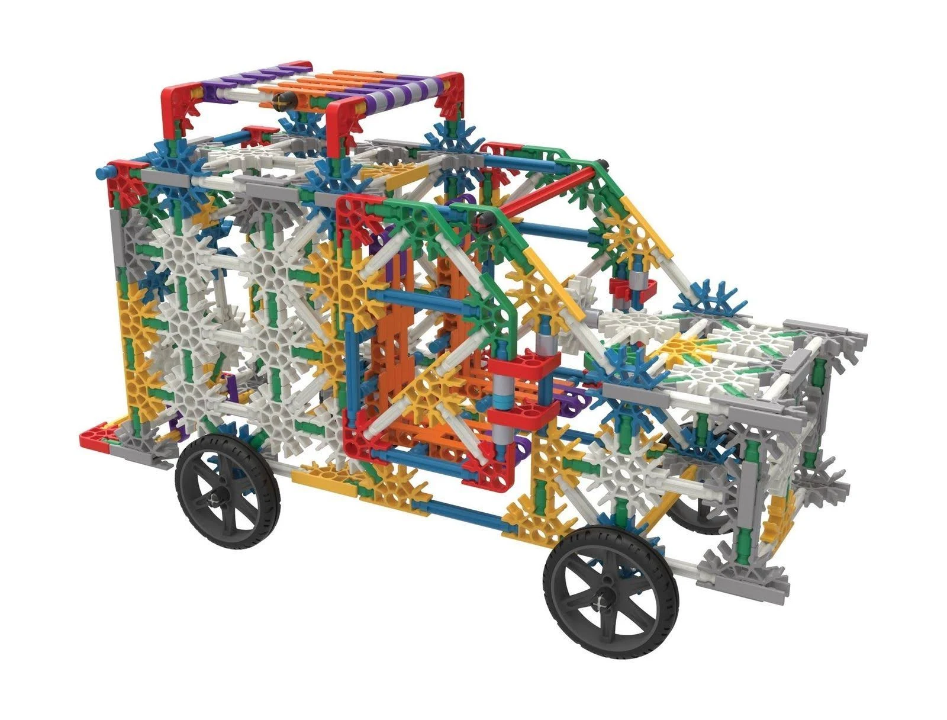
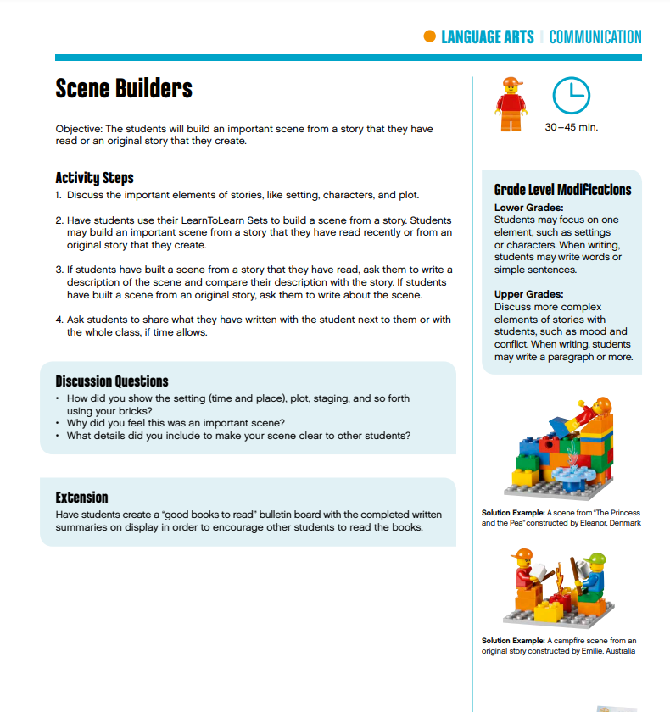
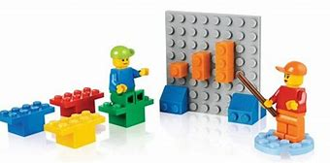
SwISTEM Equipment Lending Service
K-Nex Maker Kits
This kit contains 863 pieces, including rods, stems, and connectors. Students can free build or use the booklet to build structures like the Eiffel tower, cars, trucks, Ferris wheels, and more! Great for challenge activities (who can build the tallest structure? Who can make the best helicopter?). We have 14 of these kits.
Maker Kit Building Guide
Lego Learn to Learn
Lego Learn to Learn lets each student have their own 65- piece Lego set, complete with mini-figurines as well as basic pieces. Middle School teachers primarily use this set for ice-breaker activities as well as Language Arts. (I know… technically not STEM… shhh). We have 45 sets available.
Lego Learn to Learn Curriculum Guide

Slide 12
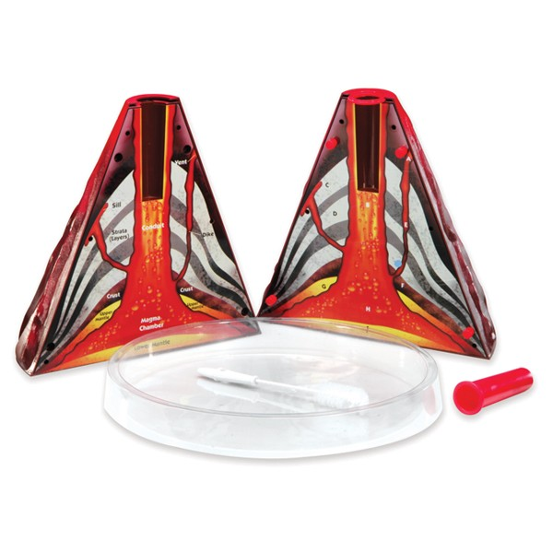
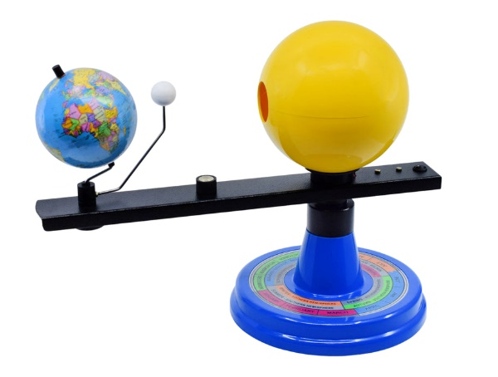
SwISTEM Equipment Lending Service
Earth and Space Science
We have many different pieces of equipment designed to rock your Earth and Space Science class!
Volcano Models (includes a recipe for making lava)
Rock Sets and Mineral Sets. We now have smaller sets– each set has 15 rocks or minerals
Solar System Orbiters
We recently updated our Orbiters to include a light simulating the sun, and we also now have a great student booklet with worksheets! Also has a good experiment guide. We also recently had a local educator write a curriculum specifically for Middle School students: Orbiter Curriculum
Washington Rock and Mineral Sets
These sets include samples of 40 different rocks and minerals along with a guide that gives a brief description of each sample. You can also request the Rock and Mineral Exploration Kit which allows students to test the samples. It includes scratch plates, magnifying lenses, magnets, and dilute Hydrochloric acid.

Slide 13
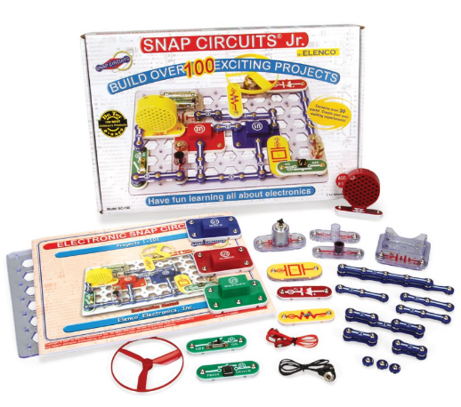
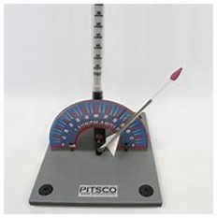
SwISTEM Equipment Lending Service
Snap Circuits Junior
We recently invested in 20 of these Snap Circuit Junior kits. They are a great way to teach about electricity as well as following directions! Each kit comes with a booklet that guides students in creating over 100 different projects. If you want to focus on circuits, you can use the kits with our Electricity Activity. It focuses on parallel, series, and closed circuits. It also touches on insulators and conductors. And yes, batteries are included!
Straw Rocket Launchers
Each students receives their own straw to turn into a rocket! Our kit has all the supplies they need to create one… and then they are “launched” using our gentle rocket launcher (it can be used in your classroom). Great way to teach graphing, precision/ accuracy, or basic engineering design. Very popular wherever they go! This quick video show them in action:
Straw Rocket Launchers

Slide 14
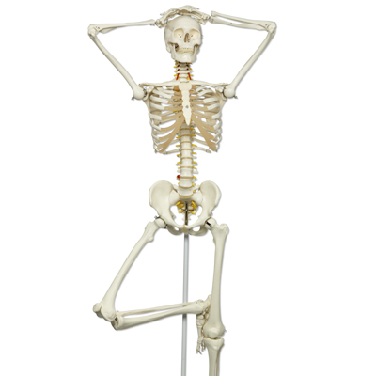
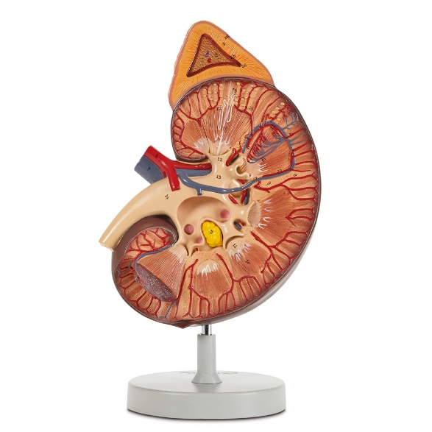
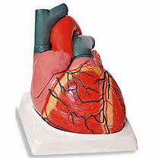
SwISTEM Equipment Lending Service
Giant Body Systems/ Organs
We have high-quality, medical grade models available:
Giant brain
Giant eye
Giant ear
Giant heart
Lifesize heart
Giant Lungs
Giant Respiratory System
Giant kidney
Skeleton
Disarticulated Skeleton (box of bones)
All models have keys and are designed for demonstration purposes. Because they are for demonstration, we have only 1 of each model.
Note: Carefree attitude NOT included. Feel free to give him any attitude you want!

Slide 15
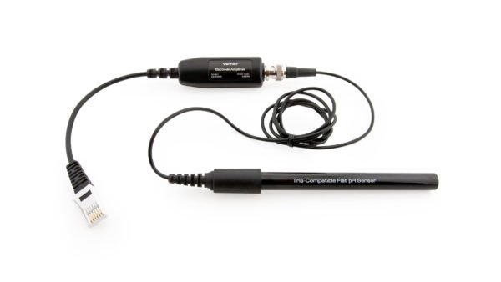
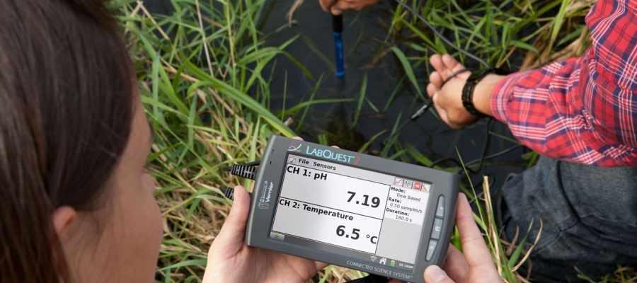
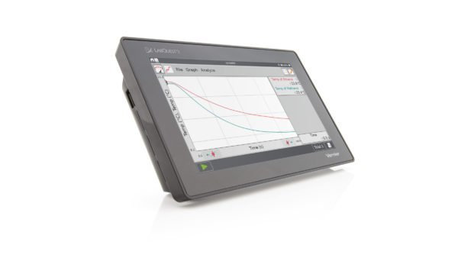
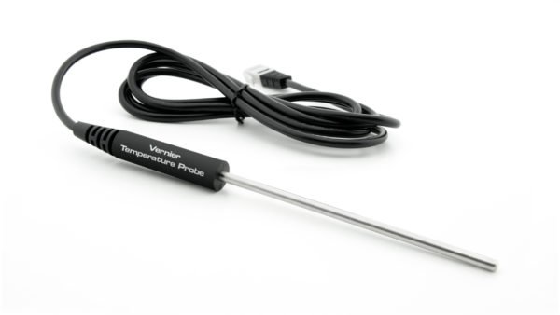
SwISTEM Equipment Lending Service
Vernier Labquest and Sensors
The Vernier Labquest is like an I-Pad that you can plug sensors in… then students can take the data and analyze it using features on the Labquest. This is the same device students will use in college science classes. With over 70 sensors, there isn’t much you can’t measure!
Vernier has even published an excellent Middle School Science Manual with easy-to-follow Lab directions.
Middle School Science with Vernier (manual)
Middle School Science with Vernier lab directions
Sensors Popular with Middle School Teachers:
pH
Temperature
Dual Range Force Sensors
Motion Detectors
Dissolved Oxygen Sensors

Slide 16
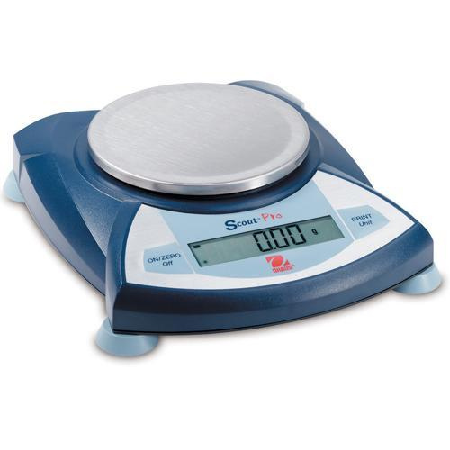
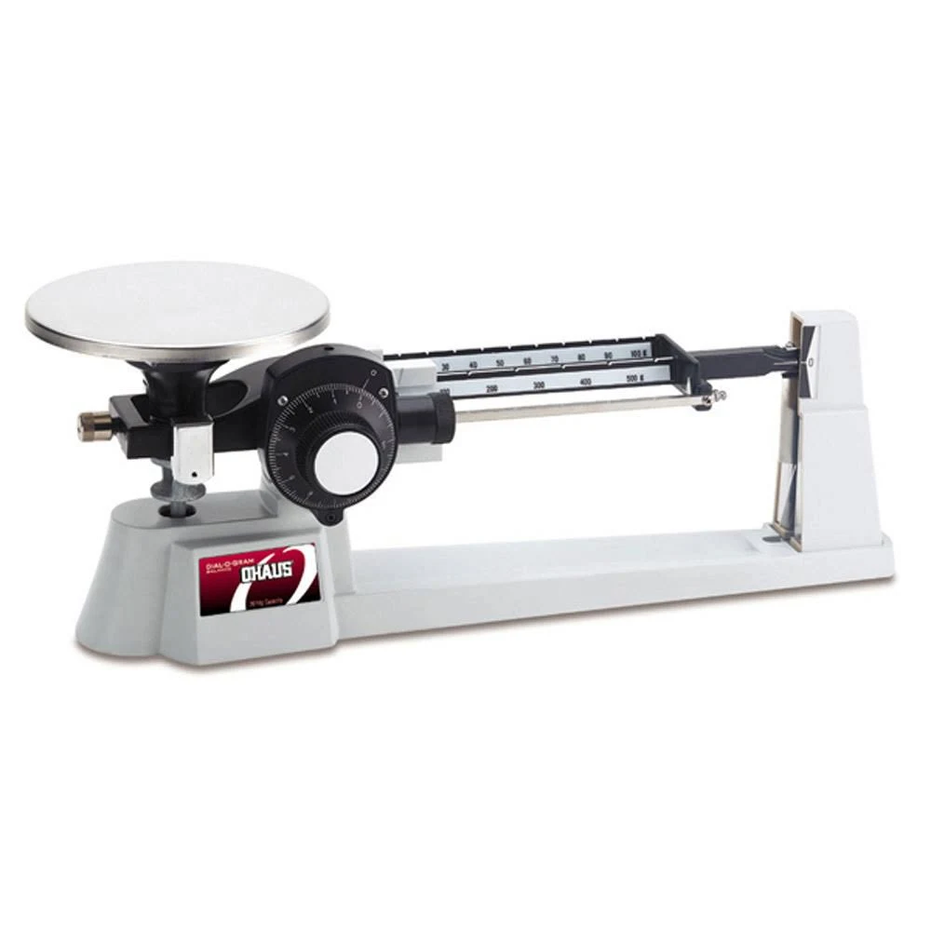
SwISTEM Equipment Lending Service
Measurement Equipment
For more basic science classes, we have several pieces of equipment that make teaching about measurement a piece of cake… okay, at least easier and more hands-on…
Meter Sticks
Measuring Tapes
Graduated Cylinders
Scales/ Balances
Triple Beam Balances
Elementary Balances (pictured)
Digital Balances
Measuring Cups/ Tablespoons/ Teaspoons
Gallon Measurement Set (pictured)
Liter Measurement Set
Thermometers

Slide 17
SwISTEM Equipment Lending Service
Ready to Request Some Materials?
Go to our web site at Equipment Lending Service and click on the “Reserve” Button
OR just click here:
Reserve Materials
Still Have Questions?
We love to talk to customers. We are a small service, so we know how our materials are used by other educators and can help you pick the perfect materials for whatever STEM topic you are teaching!
So please… don’t hesitate to call or e-mail!!!
Paige: 812-205-5501
pdwalling@usi.edu

